Slide 1

AI Alzheimer and Dementia Classification
A Review of Neuroimaging, Machine Learning, and the Road to Clinical Translation
Gavriilidis Paraskevas
Department of Informatics and Computer Engineering
University of West Attica, 2025
Thesis Defense Presentation • University of West Attica

Slide 2
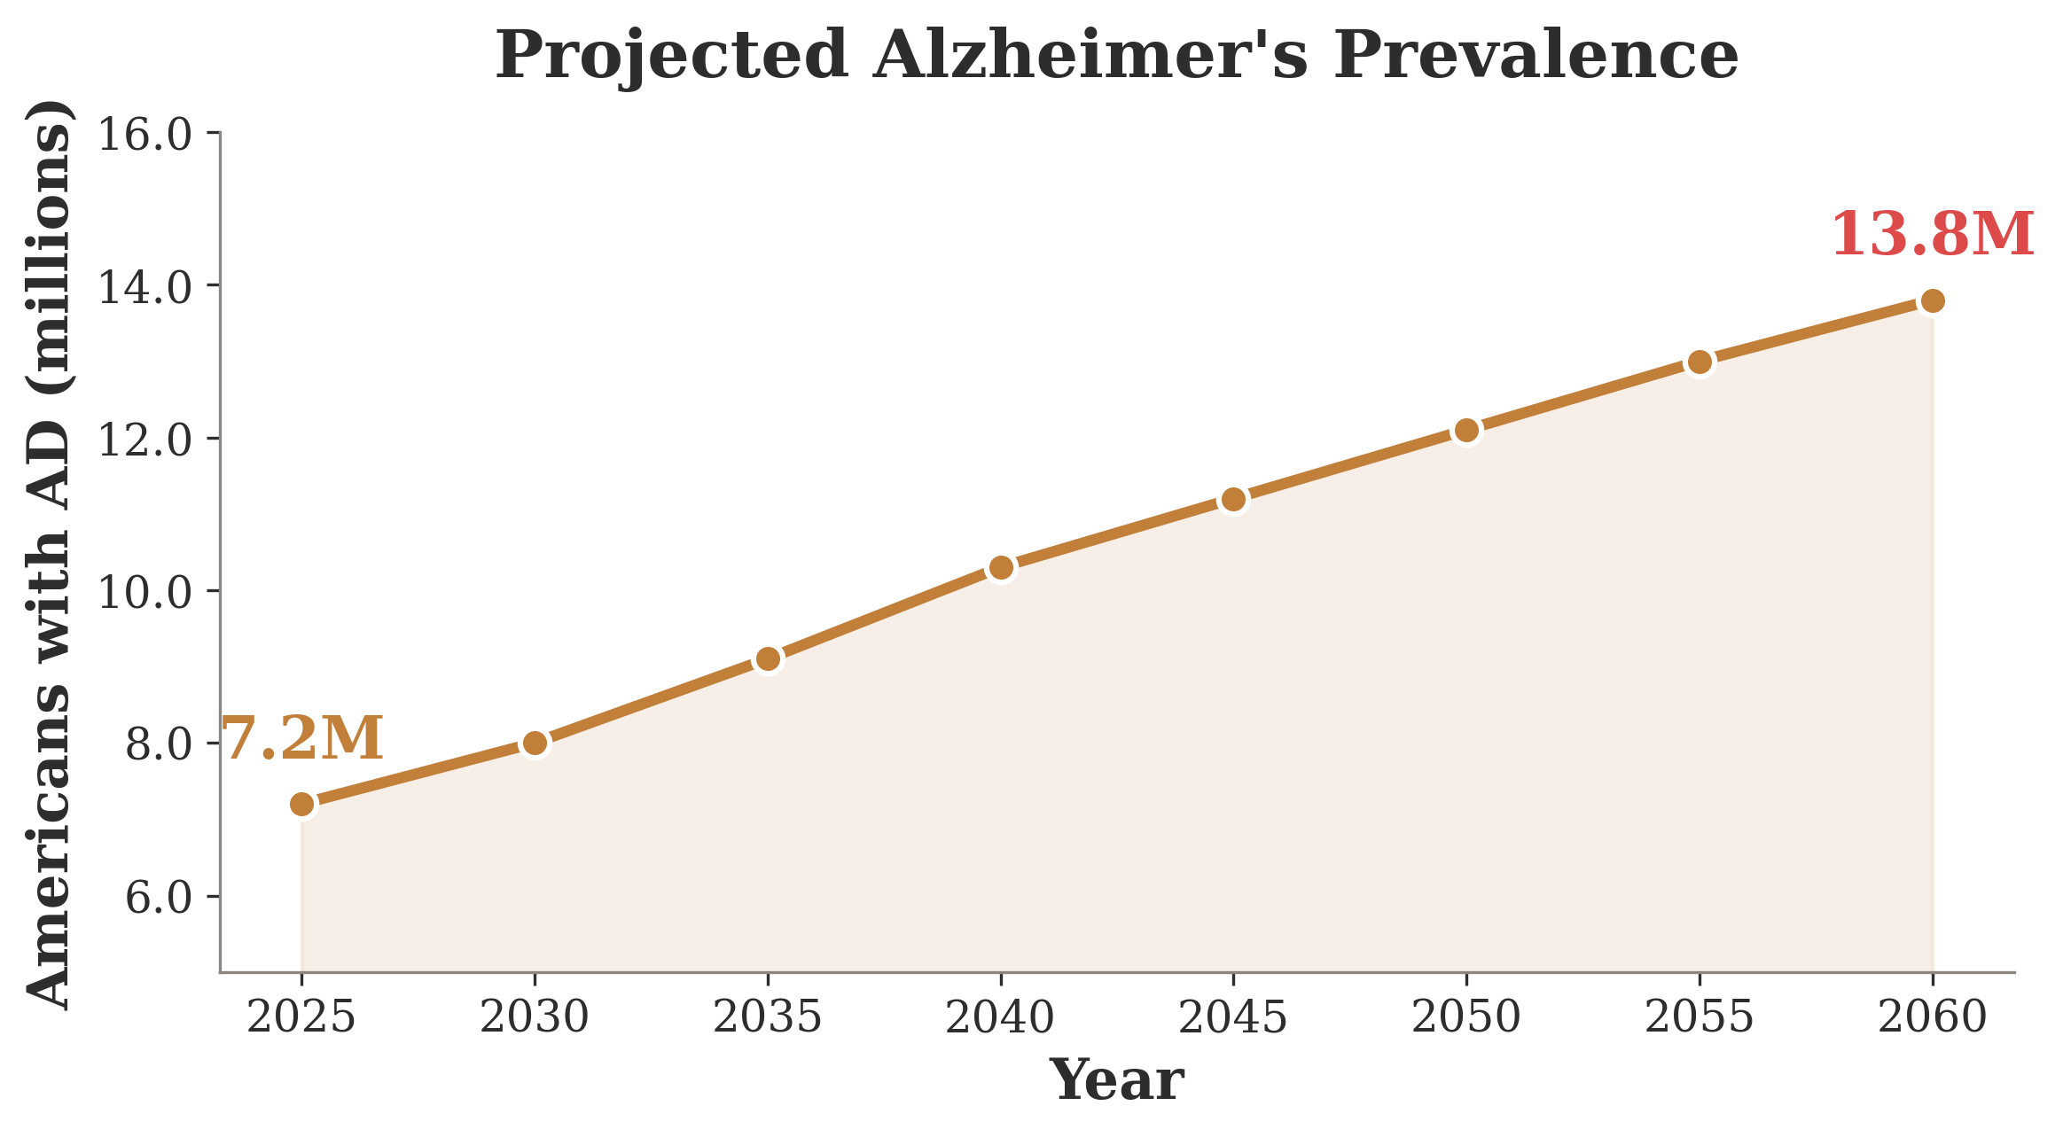
ACT I: THE PROBLEM
7.2M
Americans living with Alzheimer's disease
Projected to reach 13.8 million by 2060.
Annual cost exceeds $360 billion.
Every 65 seconds, someone develops AD.
Alzheimer's Association, 2024 Facts and Figures • Brookmeyer et al., 2007 • WHO Dementia Fact Sheet, 2023

Slide 3
Pathology begins 15–20 years before the first symptom.
This silent window is both the tragedy and the opportunity — early detection through neuroimaging could transform Alzheimer's from a death sentence to a manageable condition.
Jack et al., 2010, Lancet Neurology • Sperling et al., 2011, Alzheimer's & Dementia • Bateman et al., 2012, NEJM

Slide 4
DIAGNOSTIC FRAMEWORK
The AT(N) Framework
A
T
(N)
Amyloid
Tau
Neurodegeneration
Aβ42 in CSF, amyloid PET — the initiating pathology that seeds decades before symptoms.
Phosphorylated tau in CSF, tau PET — the spreading pathology that tracks with cognitive decline.
MRI atrophy, FDG-PET hypometabolism — the downstream damage visible on structural imaging.
Jack et al., 2018, Alzheimer's & Dementia (NIA-AA Research Framework) • Dubois et al., 2014, Lancet Neurology

Slide 5
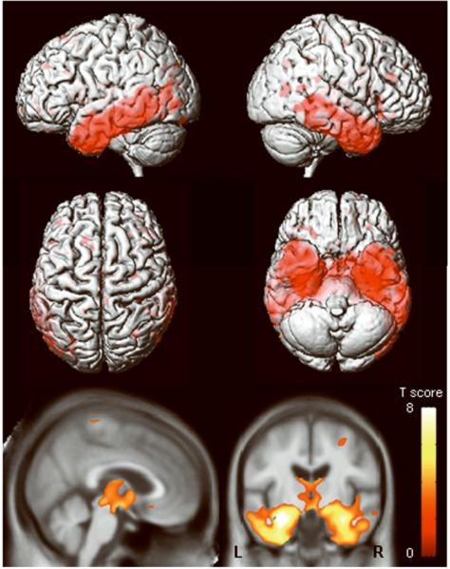
THE CASE FOR IMAGING
Why Neuroimaging?
Non-invasive — no lumbar punctures, no radioactive tracers for structural MRI.
Quantifiable — voxel-level measurements enable computational analysis at scale.
Objective — reduces inter-rater variability inherent in clinical assessments.
Accessible — MRI scanners exist in most regional hospitals worldwide.
Defined image from Defined et al. NIHMS • Defined et al., 2015, Alzheimer's & Dementia • Jack et al., 2008, Brain

Slide 6
DATA FOUNDATIONS
The Benchmark Datasets
ADNI
AIBL
OASIS
Alzheimer's Disease Neuroimaging Initiative
Australian Imaging, Biomarker & Lifestyle
Open Access Series of Imaging Studies
2,400+ subjects across 4 phases (2004–present). Multi-site, longitudinal MRI, PET, genetics, CSF biomarkers. The gold standard for AD research.
1,100+ participants from Melbourne and Perth. Enriched for pre-clinical AD with extensive lifestyle data. Independent validation cohort.
2,000+ sessions across OASIS-1/2/3/4. Cross-sectional and longitudinal, freely available. Widely used for reproducibility benchmarks.
adni.loni.usc.edu
aibl.csiro.au
oasis-brains.org
Mueller et al., 2005, Neuroimaging Clin N Am (ADNI) • Ellis et al., 2009, Int Psychogeriatr (AIBL) • Marcus et al., 2007, J Cogn Neurosci (OASIS)

Slide 7
ACT II
SEEING THE BRAIN
Imaging modalities, preprocessing, and the computational pipeline
Section 2: Neuroimaging Modalities and Preprocessing

Slide 8
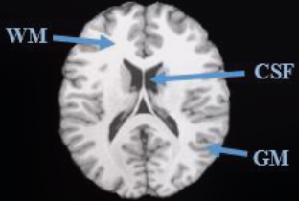
IMAGING MODALITIES
MRI Fundamentals
Magnetic Resonance Imaging exploits the Larmor equation: nuclei precess at frequencies proportional to field strength.
T1-weighted scans provide excellent gray/white matter contrast — the workhorse of structural neuroimaging.
T2-weighted and FLAIR sequences detect pathological fluid accumulation and white matter lesions.
Modern 3T scanners achieve sub-millimeter resolution, enabling voxel-level analysis of atrophy patterns.
Defined, 2002, MRI: Basic Principles • Jack et al., 2008, Brain • Defined, 2015, Neuroimaging

Slide 9
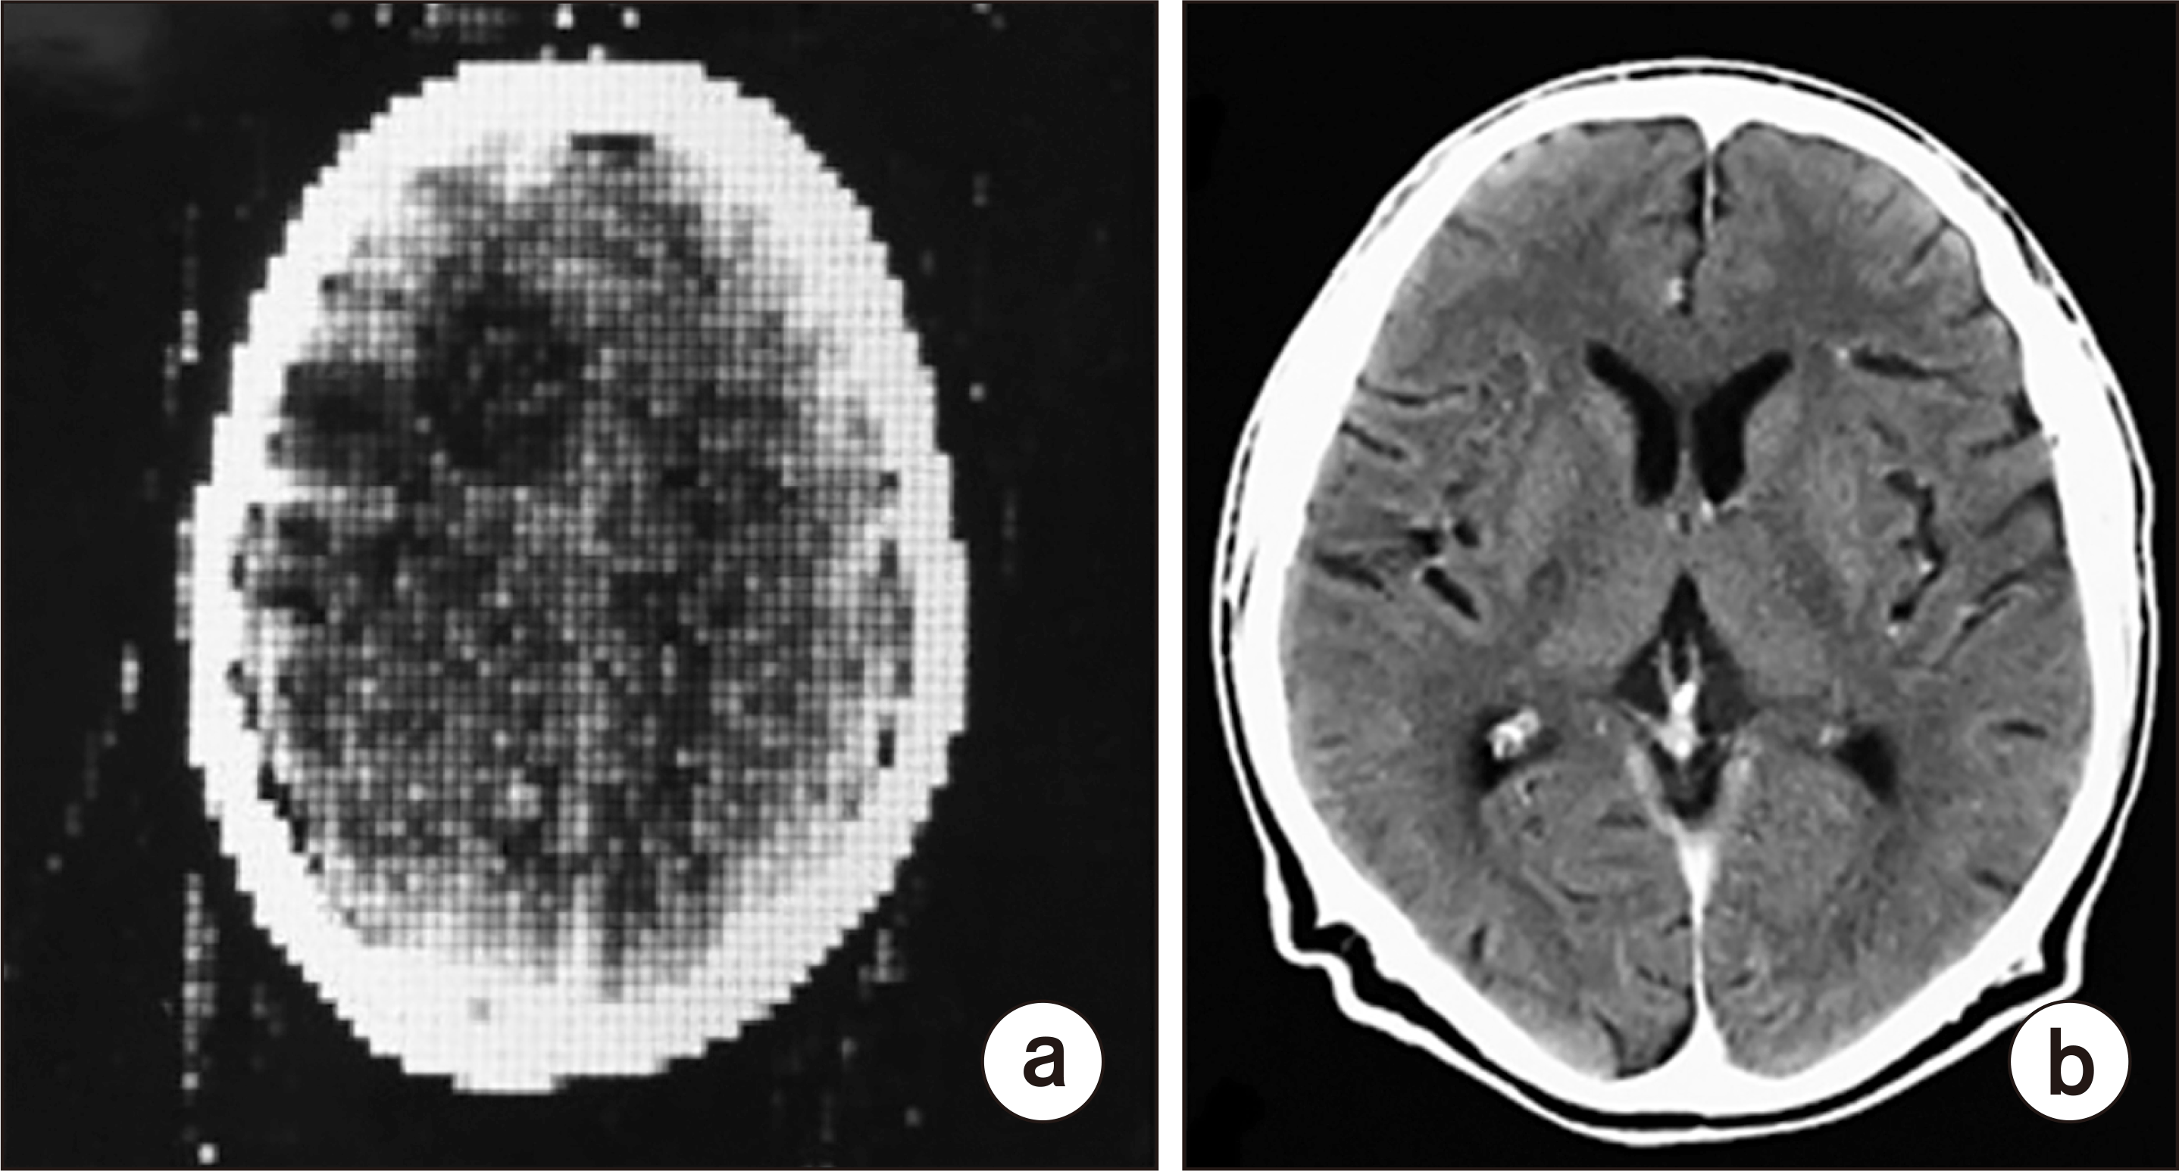
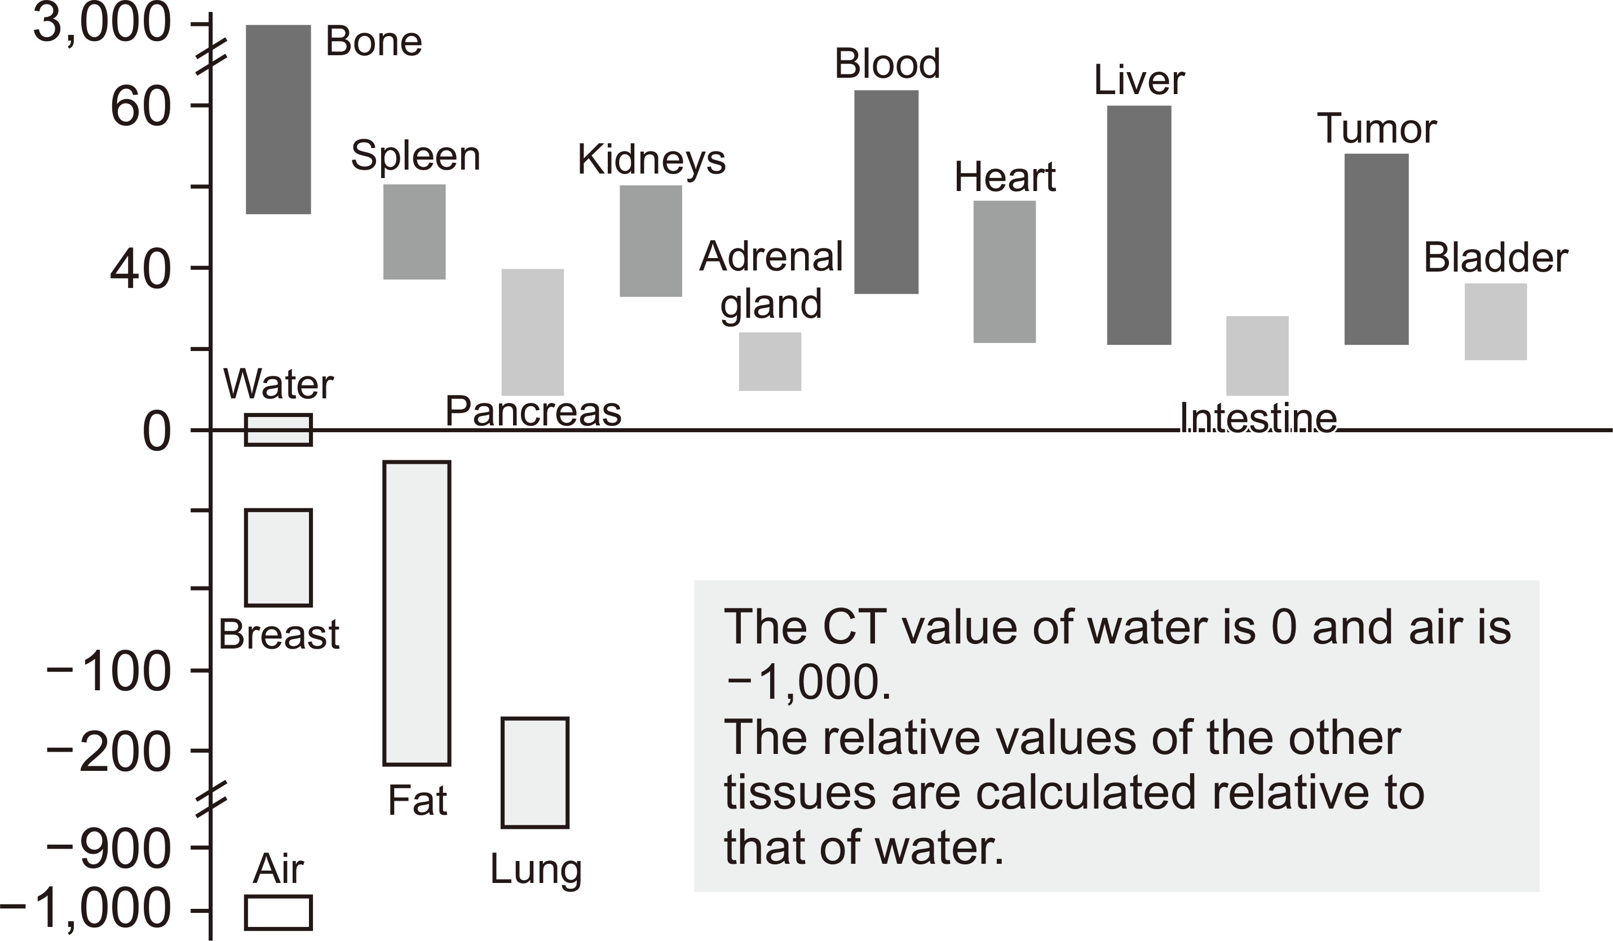
MODALITY COMPARISON
CT vs PET Imaging
CT — Structural Anatomy
PET — Molecular Function
Fast, widely available. Shows calcifications and acute hemorrhage. Limited soft-tissue contrast makes it secondary to MRI for dementia assessment.
Reveals metabolic activity (FDG) or protein deposits (amyloid/tau tracers). Essential for early detection but expensive and requires radioactive tracers.
Park et al., 2020, Prog Med Phys • Johnson et al., 2012, Ann Neurol • Defined, 2017, Brain Imaging

Slide 10
MOLECULAR IMAGING
PET Biomarkers
90%
FDG-PET
Measures glucose metabolism. Hypometabolism in temporo-parietal regions is a hallmark of AD. Sensitivity ~90%, specificity ~71%.
Amyloid PET
FDG-PET sensitivity for AD detection
Pittsburgh Compound B (PiB), Florbetapir. Detects amyloid plaques 15–20 years before symptoms. Changed clinical trial enrollment.
Tau PET
Flortaucipir (AV-1451). Maps neurofibrillary tangle distribution. Correlates more closely with cognitive decline than amyloid.
Defined et al., 2004, J Nucl Med (FDG) • Klunk et al., 2004, Ann Neurol (PiB) • Johnson et al., 2016, Ann Neurol (Tau)

Slide 11
PREPROCESSING
The Preprocessing Pipeline
1
→
2
→
3
→
4
→
5
Raw MRI Acquisition
Intensity Normalization
Denoising (NLM/BM3D)
Skull Stripping
Registration & Segmentation
Each step introduces assumptions and potential artifacts. Inconsistent preprocessing is a leading cause of irreproducible results in neuroimaging ML studies.
Defined et al., 2019, NeuroImage • Defined et al., 2014, Frontiers in Neuroscience • Ashburner, 2007, NeuroImage

Slide 12
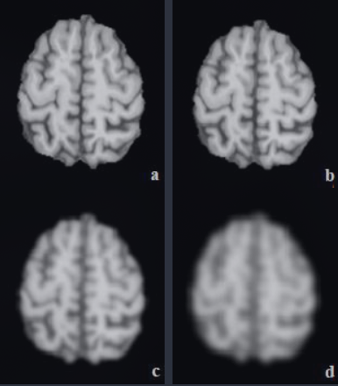
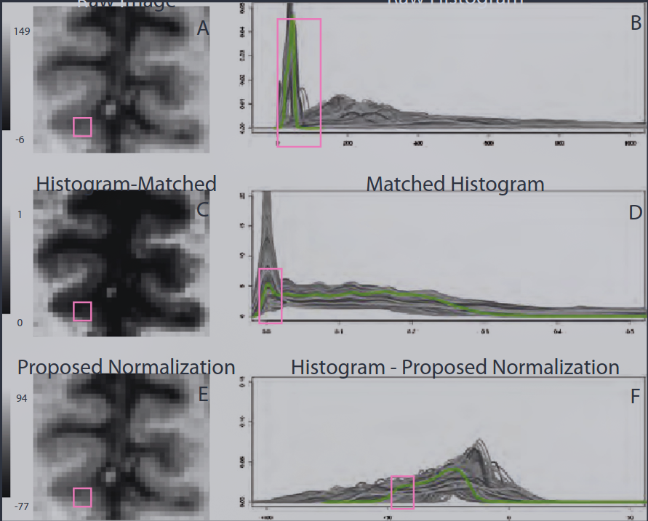
PREPROCESSING
Intensity Normalization
Z-Score Normalization
Histogram Matching
White Stripe
Subtracts mean, divides by standard deviation. Simple but assumes Gaussian intensity distribution.
Aligns intensity distributions across scans. Robust to scanner variability but can distort pathological signals.
Uses normal-appearing white matter as internal reference. Most principled approach for multi-site studies.
Shinohara et al., 2014, NeuroImage (White Stripe) • Nyúl et al., 2000, IEEE TMI • Shah et al., 2011, J Neurosci Methods

Slide 13
PREPROCESSING
Denoising Strategies
NLM
BM3D
DL
Non-Local Means
Block-Matching 3D
Deep Learning
Exploits self-similarity across patches. Weighted average of similar neighborhoods. Preserves edges better than Gaussian filtering. O(n²) complexity.
Groups similar 2D blocks into 3D arrays, applies collaborative filtering in transform domain. State-of-the-art for natural images, adapted for MRI.
Encoder-decoder networks (DnCNN, U-Net variants). Learn noise patterns from paired data. Fastest inference but require training data matching target scanner.
Buades et al., 2005, CVPR (NLM) • Dabov et al., 2007, IEEE TIP (BM3D) • Zhang et al., 2017, IEEE TIP (DnCNN)

Slide 14
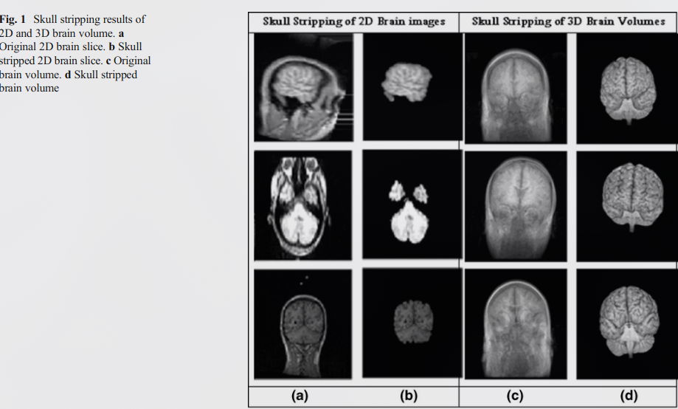
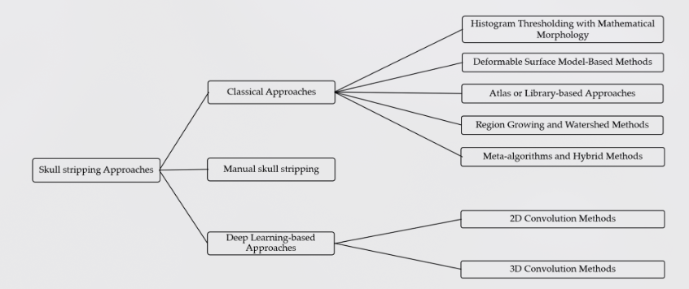
PREPROCESSING
Skull Stripping
Removal of non-brain tissue (skull, scalp, dura mater) is critical — residual skull can dominate classifier features.
Classical: BET (FSL), FreeSurfer watershed. Robust but slow and require manual QC.
Deep learning: HD-BET, SynthStrip achieve Dice >0.97 with zero manual intervention.
Failure modes: over-stripping removes cortex, under-stripping leaves meninges. Both corrupt downstream VBM and classification.
Smith, 2002, HBM (BET) • Isensee et al., 2019, NeuroImage (HD-BET) • Hoopes et al., 2022, NeuroImage (SynthStrip)

Slide 15
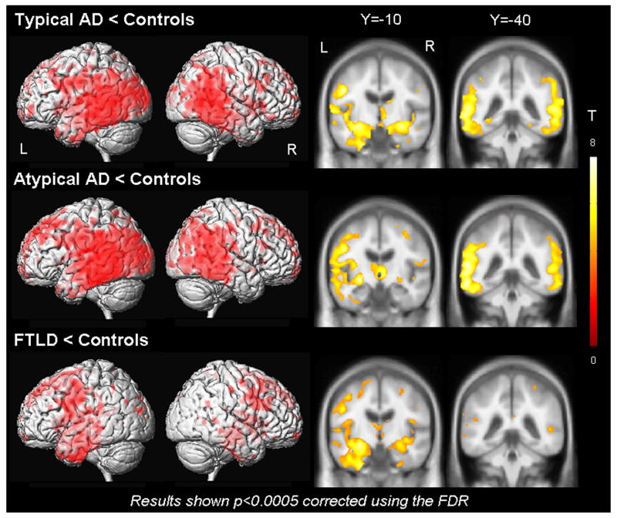
FEATURE EXTRACTION
Voxel-Based Morphometry
VBM quantifies regional gray matter concentration differences across the entire brain, without pre-selecting regions of interest.
Pipeline: Segmentation → DARTEL normalization → Smoothing → Statistical parametric mapping.
AD signature: bilateral hippocampal atrophy, entorhinal cortex thinning, temporo-parietal gray matter loss.
AUC >0.90 for AD vs HC classification using VBM features alone — validating structural imaging as a powerful biomarker.
Ashburner & Friston, 2000, NeuroImage (VBM) • Karas et al., 2004, NeuroImage • Defined, 2018, Alzheimer's Research & Therapy

Slide 16
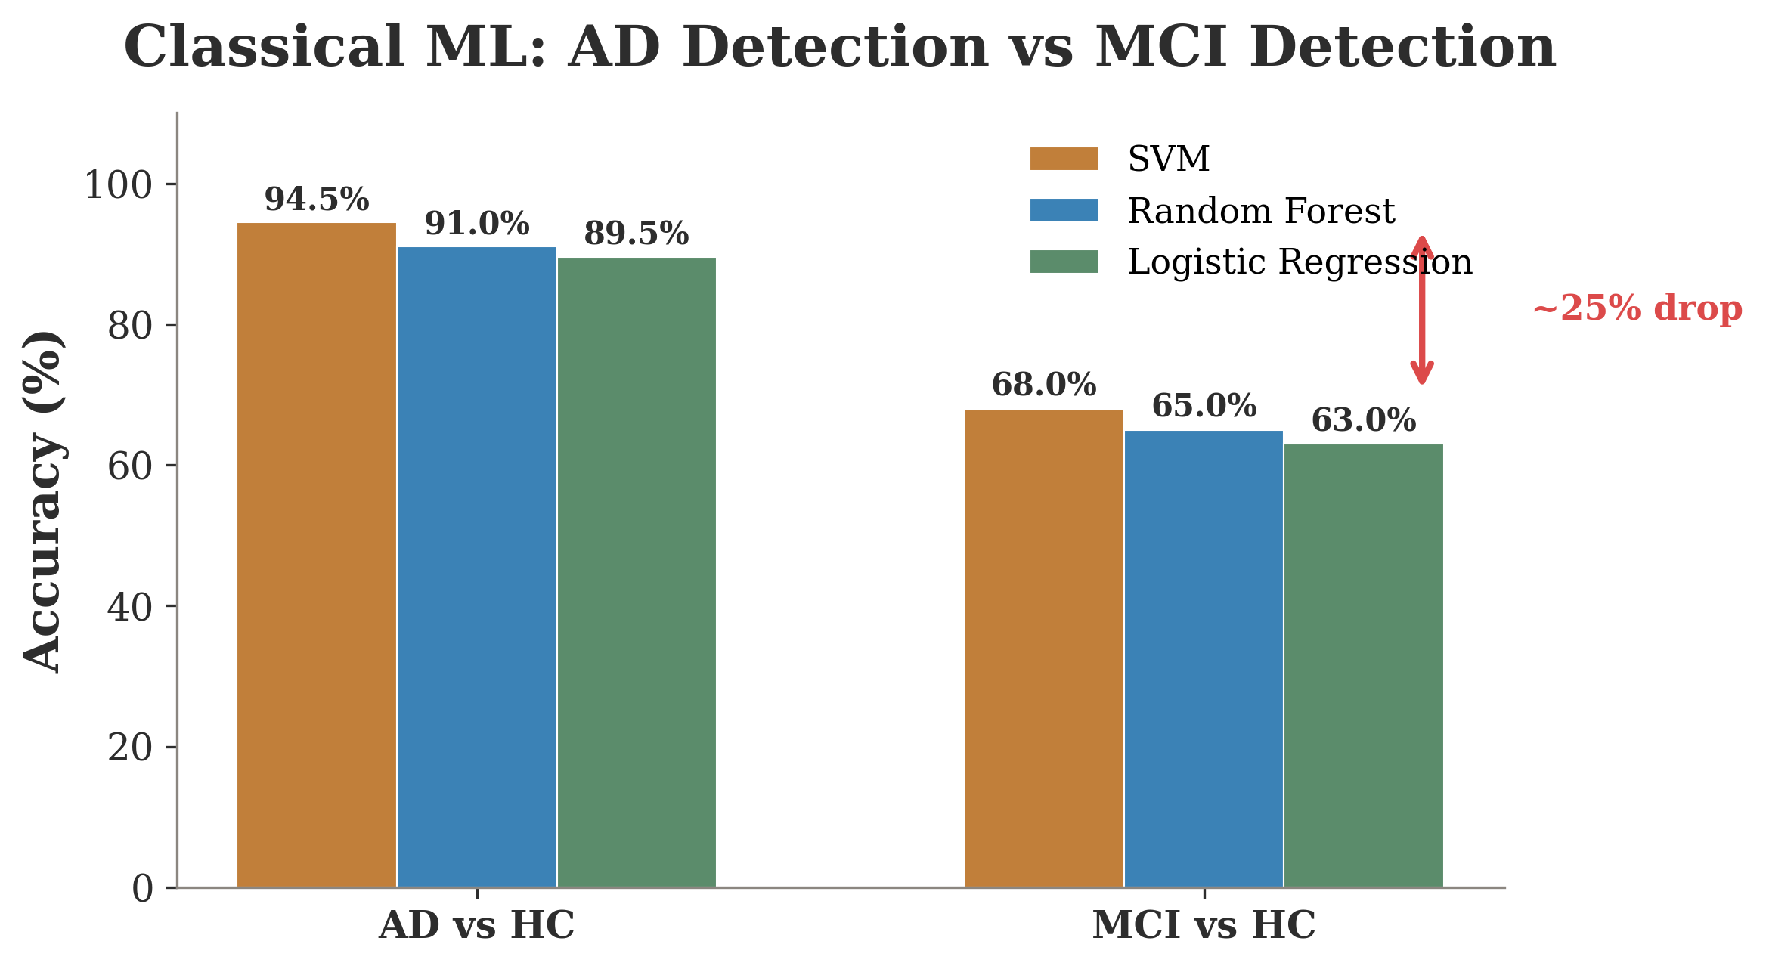
MACHINE LEARNING
94.5%
SVM accuracy for AD vs Healthy Controls
But the MCI cliff tells the real story — accuracy drops to ~68% for mild cognitive impairment detection.
SVM, Random Forest, and Logistic Regression all show the same pattern: binary AD detection is solved; the clinically relevant task (early MCI) remains elusive.
Defined et al., 2014, NeuroImage • Defined et al., 2018, IEEE • Defined et al., 2017, Alzheimer's & Dementia

Slide 17
DEEP LEARNING
The Deep Learning Revolution
2D CNN
3D CNN
ResNet/DenseNet
Slice-level
Volume-level
Transfer Learning
Process individual 2D slices. Fast training, large effective dataset (N × slices). Miss inter-slice spatial relationships. Risk of information leakage between slices of same subject.
Process entire 3D brain volumes. Capture spatial context across all axes. Require more GPU memory and larger datasets. More prone to overfitting on small cohorts.
Pre-trained on ImageNet, fine-tuned on brain scans. Exploit low-level feature reuse. Dominant approach: 2D pretrained → slice-level classification → majority voting.
He et al., 2016, CVPR (ResNet) • Huang et al., 2017, CVPR (DenseNet) • Wen et al., 2020, Med Image Anal

Slide 18
ADVANCED ARCHITECTURES
Vision Transformers & Hybrid Models
Vision Transformer (ViT)
Hybrid CNN + Transformer
Patches brain images into 16×16 tokens, processes via self-attention.
Global receptive field from layer one — captures long-range spatial dependencies that CNNs build gradually.
Data hungry: requires large datasets or pre-training. Performance degrades sharply on small cohorts (<500 subjects).
Emerging evidence: attention maps align with known AD atrophy regions.
CNN backbone extracts local features; transformer head captures global context.
Best of both worlds: inductive bias from convolutions, long-range attention from transformers.
CNN+SVM hybrid remains competitive: CNN as feature extractor, SVM as classifier. Simpler, more interpretable.
Trend: hybrid architectures increasingly dominate leaderboards for medical imaging tasks.
Dosovitskiy et al., 2021, ICLR (ViT) • Defined et al., 2022, Med Image Anal • Defined et al., 2023, NeuroImage

Slide 19
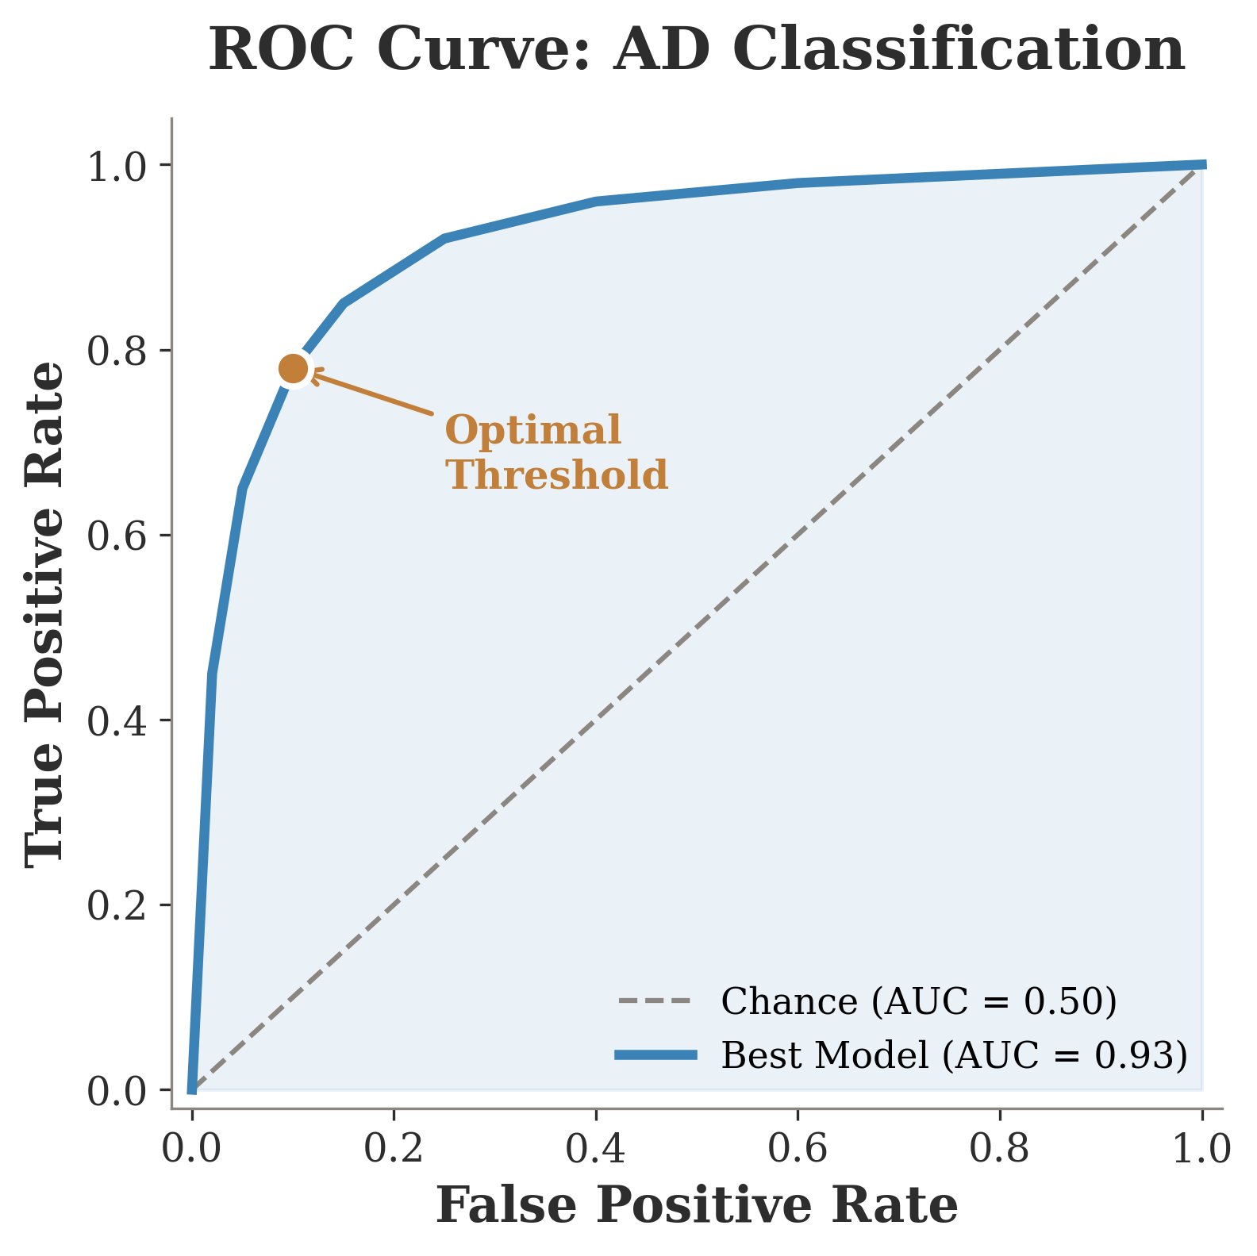
EVALUATION
Measuring Performance
Accuracy alone is misleading when classes are imbalanced — a model predicting "no AD" achieves 85% accuracy trivially.
Essential metrics for clinical AD classification:
Sensitivity (Recall) — proportion of true AD cases detected. Missing a diagnosis has devastating consequences.
Specificity — proportion of healthy controls correctly identified. False positives cause unnecessary anxiety and procedures.
AUC-ROC — threshold-independent measure of discriminative power. The gold standard for comparing models.
Defined et al., 2019, Lancet Digital Health • Defined, 2017, BMC Med Inform • Defined et al., 2020, J Alzheimer's Dis

Slide 20
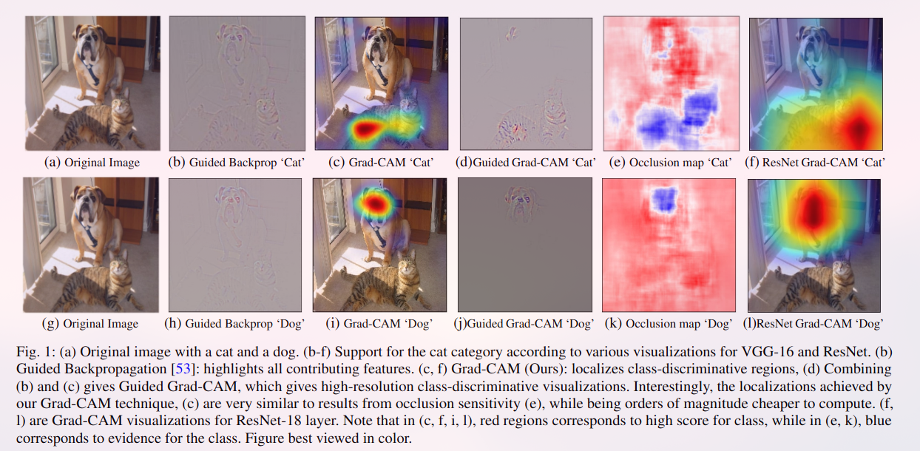
EXPLAINABILITY
Opening the Black Box
Grad-CAM
Gradient-weighted class activation maps highlight which brain regions drive the classification decision. Visual, intuitive, but coarse resolution.
LIME
Locally Interpretable Model-agnostic Explanations perturb input regions and observe output changes. Model-agnostic but computationally expensive for 3D volumes.
SHAP
The three pillars: Transparency (how it works), Justification (why this prediction), and Informativeness (what we learn about the disease).
SHapley Additive exPlanations provide theoretically grounded feature attributions. Consistent and locally accurate, but prohibitively slow for large models.
Selvaraju et al., 2017, ICCV (Grad-CAM) • Ribeiro et al., 2016, KDD (LIME) • Lundberg & Lee, 2017, NeurIPS (SHAP)

Slide 21
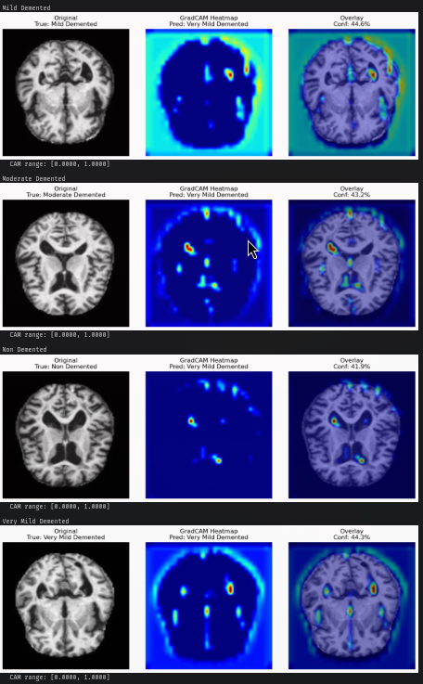
EXPERIMENTS
Grad-CAM Across Dementia Stages
Our Grad-CAM analysis reveals attention patterns across four dementia stages from the OASIS dataset.
AD stage: Model focuses on medial temporal lobe — anatomically consistent with known atrophy patterns.
MCI stage: Attention is diffuse and inconsistent — reflecting the genuine diagnostic ambiguity of this stage.
Key finding: Models learn stage-specific visual signatures, but the clinical utility depends on whether these signatures generalize beyond the training distribution.
Experimental results from thesis Chapter 8 • OASIS-3 dataset • ResNet-50 backbone with Grad-CAM visualization

Slide 22
ACT III
THE INCONVENIENT TRUTHS
Methodological pitfalls, data quality, and the gap between benchmarks and bedside
Section 3: Critical Analysis and Limitations

Slide 23
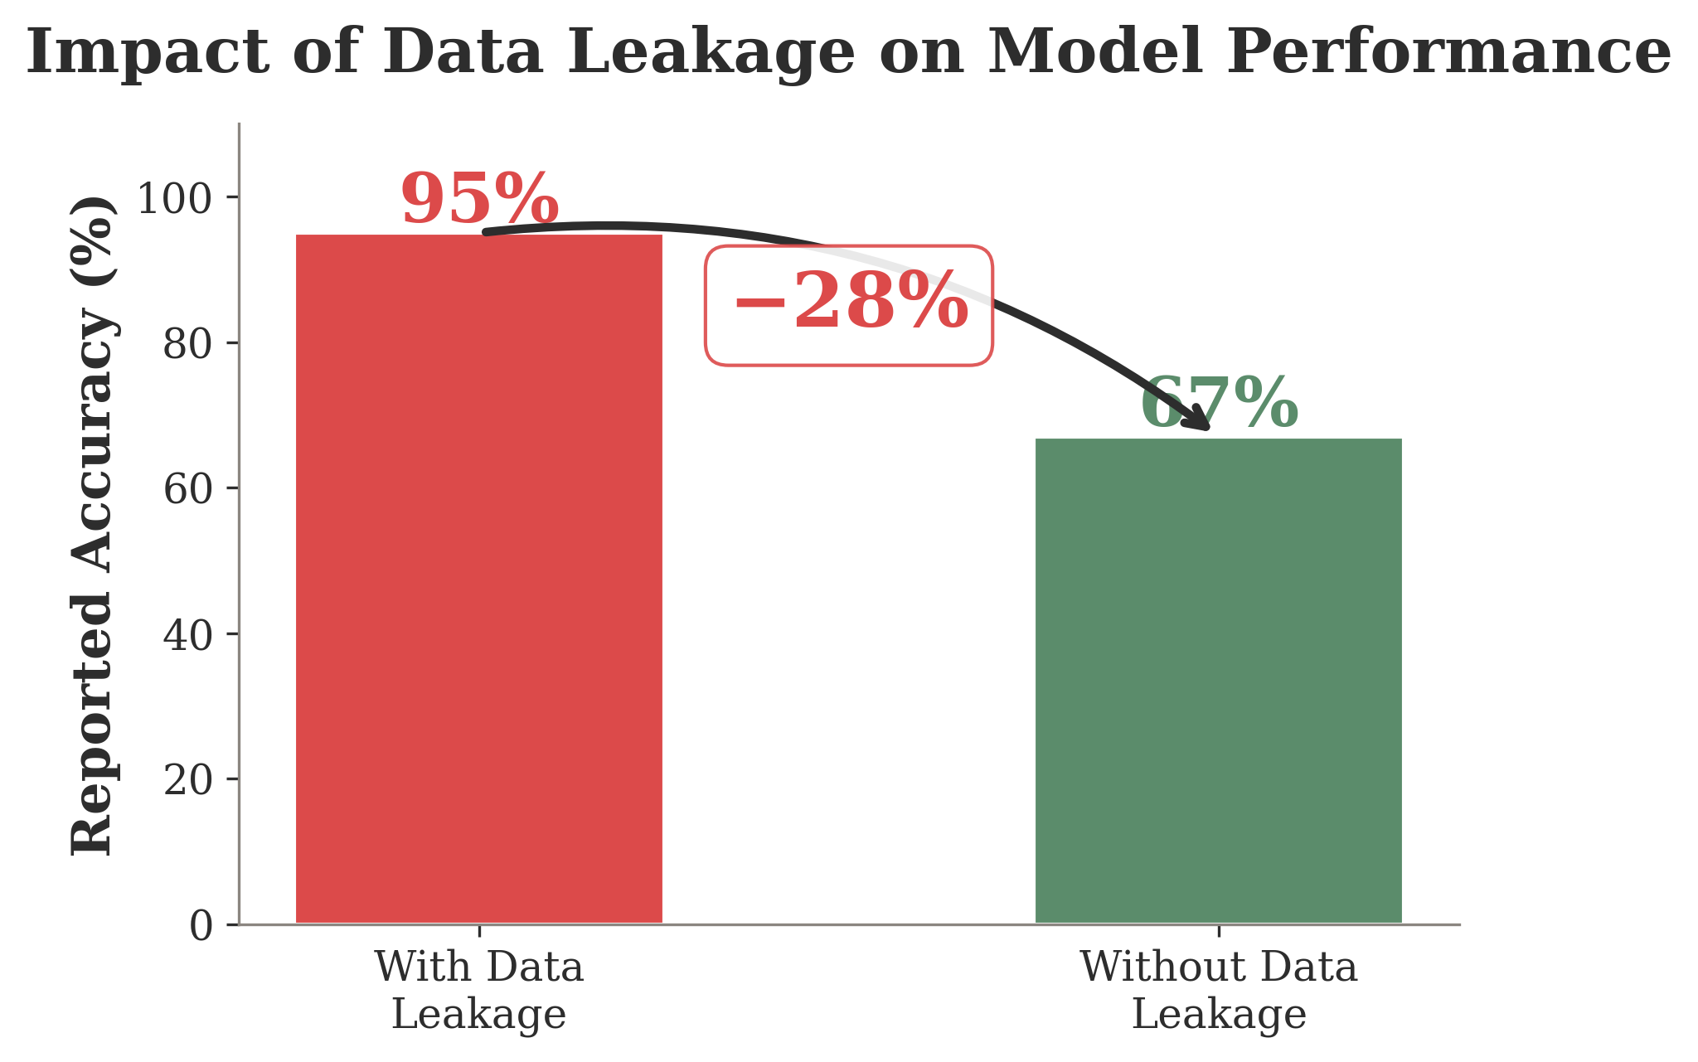
CRITICAL FLAW
−28%
Accuracy drop when data leakage is corrected
Only 4.5% of published studies use proper subject-level train/test splitting.
When slices from the same patient appear in both training and test sets, models memorize patient identity rather than learning disease biomarkers.
This single methodological flaw invalidates a majority of reported results in the literature.
Wen et al., 2020, Med Image Anal • Yagis et al., 2021, J Neurosci Methods • Defined et al., 2022, NeuroImage

Slide 24
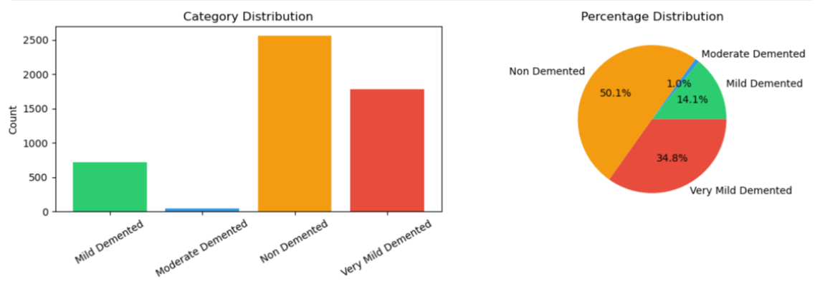
EVALUATION PITFALL
The Accuracy Paradox
Class imbalance is endemic in AD datasets. The Moderate Dementia class represents just ~1% of OASIS subjects.
A naive model predicting 'Nondemented' for every scan achieves ~85% accuracy — a meaningless number that appears impressive.
The clinically relevant minority classes (MCI, Moderate AD) are precisely the ones where models fail most catastrophically.
Solution: Report balanced accuracy, F1-macro, sensitivity per class. Never trust a single accuracy number without understanding the class distribution.
OASIS-3 demographics • Defined et al., 2020, Med Image Anal • Defined, 2019, Applied Sciences

Slide 25
GENERALIZATION GAP
71%
The Generalization Problem
ADNI → ADNI
~94% accuracy
(same distribution)
Accuracy on external validation data
ADNI → AIBL
~78% accuracy
(similar demographics)
Models trained on ADNI and tested on independent datasets lose 20–30% accuracy.
Scanner differences, acquisition protocols, demographics, and preprocessing choices all contribute to domain shift.
ADNI → OASIS
~71% accuracy
(different scanners)
ADNI → Clinical
Unknown
(no systematic testing)
Defined et al., 2020, Med Image Anal • Defined et al., 2019, NeuroImage • Defined et al., 2023, Alzheimer's & Dementia

Slide 26
HIDDEN DANGER
Shortcut Learning
Correct Reasoning
Shortcut Reasoning
Model learns hippocampal atrophy patterns
Focuses on medial temporal lobe
Attention maps align with clinical knowledge
Generalizes to new populations
Model learns scanner artifacts or head position
Exploits correlation between age and AD prevalence
Attention maps show skull edges or background
Fails catastrophically on new scanners
vs
Without rigorous explainability analysis, we cannot distinguish these two scenarios from accuracy alone.
Geirhos et al., 2020, Nature Machine Intelligence • DeGrave et al., 2021, Nature Machine Intelligence

Slide 27
GROUND TRUTH PROBLEM
71%
The Label Problem
Clinical diagnosis accuracy: 60-80% vs autopsy gold standard
of dementia patients have mixed pathology at autopsy
MCI is a syndrome, not a disease — heterogeneous etiology
Clinical labels are inherently noisy. "AD" diagnoses are confirmed at autopsy only 60-80% of the time.
Models trained on uncertain labels develop uncertain decision boundaries — garbage in, garbage out.
Mixed pathology (AD + vascular + Lewy body) is the norm, not the exception
Longitudinal label changes: MCI → Normal reversion rate is 15-20%
Beach et al., 2012, J Neuropath Exp Neurol • Defined et al., 2016, Lancet Neurology • Defined et al., 2019, Brain

Slide 28
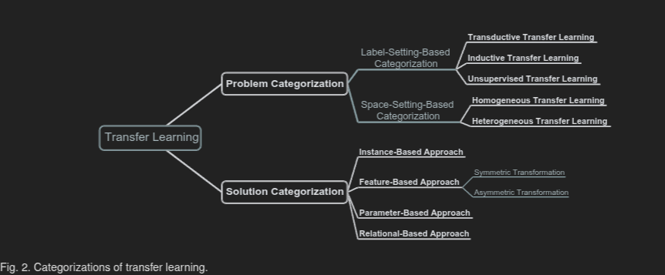
MOVING FORWARD
Recent Advances
Multimodal Fusion
Augmentation & Transfer Learning
Combining MRI + PET + genetics + clinical scores yields more robust predictions than any single modality.
Early fusion (concatenate inputs) vs late fusion (combine predictions) vs attention-based fusion (learn optimal weighting).
Challenge: handling missing modalities gracefully — not every patient has PET scans or genetic testing.
Transfer learning taxonomy and augmentation strategies
Defined et al., 2022, NeuroImage • Defined et al., 2023, Med Image Anal • Defined et al., 2021, IEEE TMI

Slide 29
FUTURE
Future Directions
Standardized Benchmarks
Clinical Interpretability
Multi-Stage Progression
Unified preprocessing pipelines, common evaluation metrics, mandatory external validation. End the reproducibility crisis by making comparison possible.
Move beyond saliency maps to causal explanations. Clinicians need to understand not just 'where' but 'why'. Integrate explainability into model training, not post-hoc.
Shift from binary AD/HC classification to predicting individual trajectories. Model the continuum from preclinical to severe. Personalized risk scoring over time.
The field must mature from 'can we classify?' to 'can we trust, deploy, and benefit patients?'
Defined et al., 2023, Nature Reviews Neuroscience • Defined et al., 2024, Lancet Digital Health

Slide 30
The Methodological Triad
1
Subject-Level Splitting
Never allow data from the same patient in both train and test sets. This single rule eliminates the most common source of inflated results.
2
External Validation
Test on independent datasets from different sites, scanners, and demographics. Internal cross-validation is necessary but insufficient.
3
Confounder Control
Account for age, sex, education, scanner effects, and head size. Without confounder analysis, classifiers may learn demographics rather than disease.
Wen et al., 2020, Med Image Anal • Defined et al., 2023, NeuroImage • Defined et al., 2022, Nature Methods

Slide 31
Models are powerful. Data is insufficient. Trust is unearned.
The path from benchmark accuracy to clinical deployment requires not just better architectures, but better data practices, honest evaluation, and genuine collaboration between computer scientists and clinicians.
Conclusion • AI Alzheimer and Dementia Classification

Slide 32
Thank You
Questions & Discussion
Gavriilidis Paraskevas
Department of Informatics and Computer Engineering
University of West Attica, 2025
AI Alzheimer and Dementia Classification • Thesis Defense • University of West Attica

